Slide 1

Centraal Bureau voor de Statistiek
Identification of Cybercrime Victims
External presentation 28-10-2019
Susan van Dijk – CBS Contact person
Abdoul Etaoil
Rik Verhulst
Job Bakker
Nicky Aardse
David Stenvatten

Slide 2
So far
Centraal Bureau voor de Statistiek
Recap :
The goal of our research:
The goal of this research is to give C.B.S., through the use if Machine Learning, insight in the type of cybercrime victims of the current Dutch population by determining whether cybercrime victimization is predominantly bound to people with some certain economics, demographic and psychological features.

Slide 3
So far
Centraal Bureau voor de Statistiek
Research question
Which economic, demographic and psychological features associate positively with (a type of) cybercrime victimization of Dutch citizens in 2016?

Slide 4
So far
Centraal Bureau voor de Statistiek
Types of crime
Traditional crime
Theft
Traditional Crime with IT means
Bankcard fraud
Crime with IT as as goal
DDoS
Cybercrime predictor definition of cybercrime

Slide 5
Dataset
Centraal bureau voor de Statistiek
What do we have at our disposal?
Our dataset
Police report 2016 (C: ~25, R: ~1.000.000)
SSB (C: ~25, R: ~22.000.000)
ID | Cybercrime (V) Traditional crime (X) | Features
### | X | value
### | V | value
ID | Features
### | value
### | value
SM (C: ~1900, R: ~81.000)
ID | Cybercrime | Features
### | X | value
### | V | value

Slide 6
Dataset
Centraal bureau voor de Statistiek
What do we have at our disposal?
Our dataset
Police report 2016 (C: ~25, R: ~1.000.000)
Features:
Cybercrime/Traditional crime
SSB (C: ~25, R: ~22.000.000)
Features:
Demographic
Economic
SM (C: ~1900, R: ~81.000)
Features:
Demographic
Economic
Psychological
Cybercrime/Taditional crime

Slide 7
Centraal Bureau voor de Statistiek
Exploratory data analysis

Slide 8
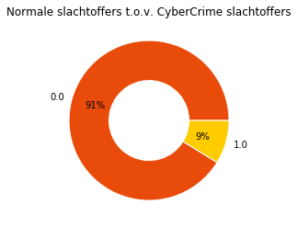
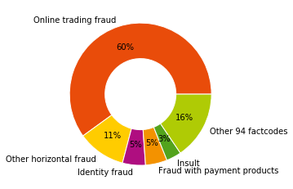
Plots
Centraal Bureau voor de Statistiek
Percentage of crime
There were about 800.000 counts of crime
All the cybercrime are predicted values
Notes:
Volle percentages gebruiken, nieuwe dataset

Slide 9
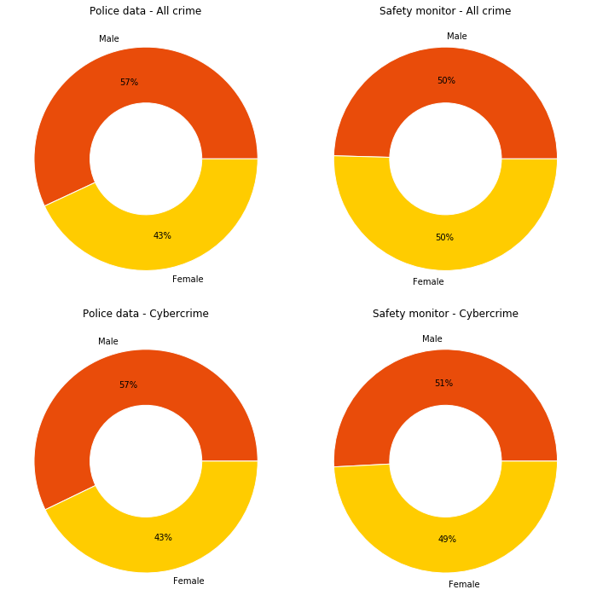
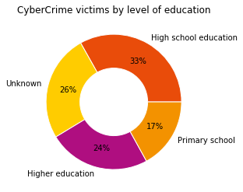
Plots
Centraal Bureau voor de Statistiek
Percentage of victims

Slide 10
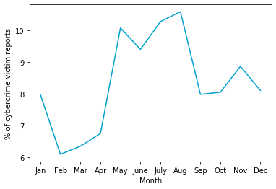
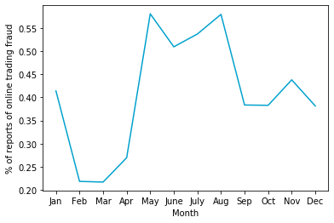
Plots
Centraal Bureau voor de Statistiek
Cybercrimes per month

Slide 11
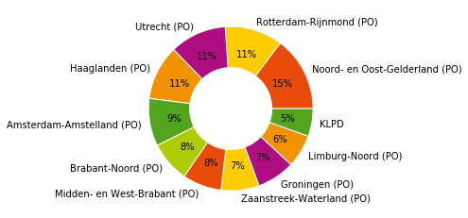
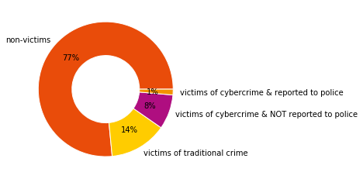
Plots
Centraal Bureau voor de Statistiek
Cybercrimes per location

Slide 12
Method
Centraal bureau voor de Statistiek
Machine learning within the project:
Decision trees
Bootstrap aggregating (Bagging)
Dimensionality reduction
PCA (Our focus)
T-SNE (Our focus)
Auto- encoders

Slide 13
Method
Centraal bureau voor de Statistiek
Data Science™
Dimensionality reduction
Feature extraction and Feature elimination

Slide 14
Method
Centraal bureau voor de Statistiek
Feature selection
“Feature selection is for filtering irrelevant or redundant features from your dataset. The key difference between feature selection and extraction is that feature selection keeps a subset of the original features while feature extraction creates brand new ones.”

Slide 15
Method
Centraal bureau voor de Statistiek
Example
ID | Cybercrime (V) | Age | Township | Sex | Age group
123 | X | 24 | Amsterdam | M | 20-55
385 | V | 55 | Rotterdam | F | 20-55
423 | X | 18 | Rotterdam | F | 12-18
231 | V | 18 | Groningen | F | 12-18
523 | V | 19 | Arnhem | M | 18-22
235 | X | 43 | Hogenveen | F | 20-55
552 | X | 75 | Maastricht | M | 55-100
Problem: too many values
(overfitting)
Problem: too many branches (features)

Slide 16
Method
Centraal bureau voor de Statistiek
Feature elimination
We have to reduce the features in the dataset manually
ID | Cybercrime (V) | Age | Township | Sex | Age group
123 | X | 24 | Amsterdam | M | 20-55
385 | V | 55 | Rotterdam | F | 20-55
423 | X | 18 | Rotterdam | F | 12-18
231 | V | 18 | Groningen | F | 12-18
523 | V | 19 | Arnhem | M | 18-22
235 | X | 43 | Hogenveen | F | 20-55
552 | X | 75 | Maastricht | M | 55-100

Slide 17
Method
Centraal bureau voor de Statistiek
Feature extraction
“Feature extraction is a process of dimensionality reduction by which an initial set of raw data is reduced to more manageable groups for processing. A characteristic of these large data sets is a large number of variables that require a lot of computing resources to process.”

Slide 18
Centraal Bureau voor de Statistiek
Dimensionality reduction
Setback

Slide 19
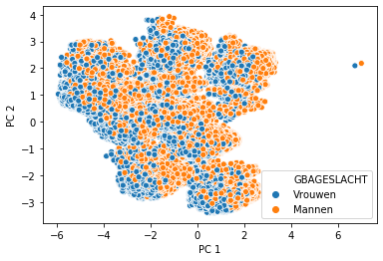
Centraal Bureau voor de Statistiek
Principal component analysis
Setback

Slide 20
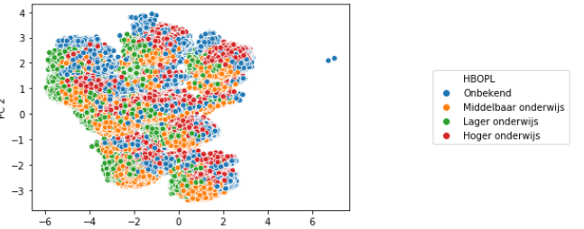
Centraal Bureau voor de Statistiek
Principal component analysis
Setback

Slide 21
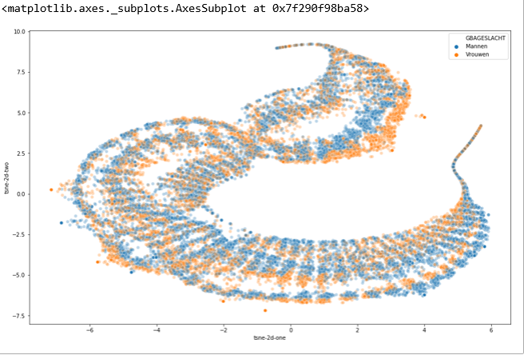
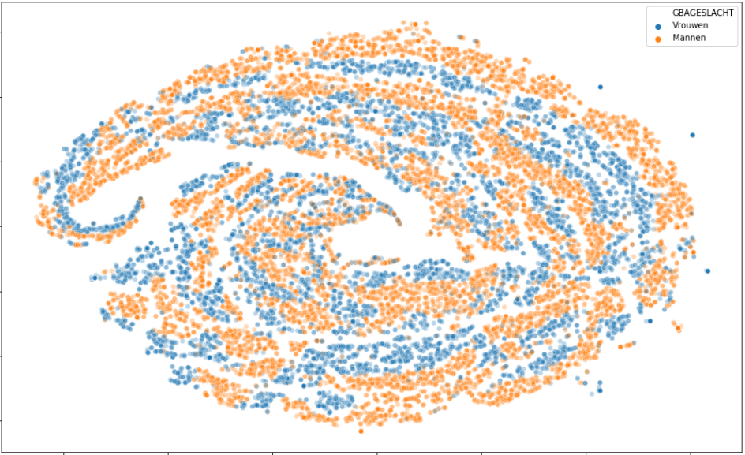
Centraal Bureau voor de Statistiek
t-SNE
Setback

Slide 22
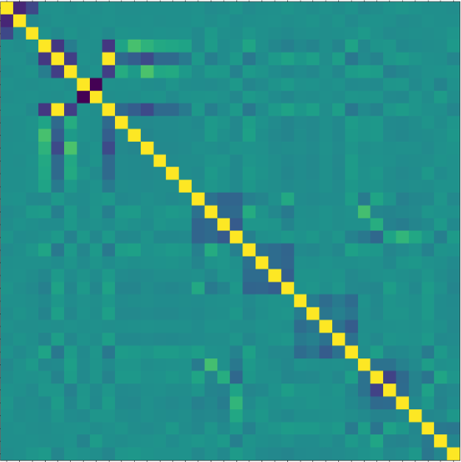
Centraal Bureau voor de Statistiek
Correlation matrix
Shows correlation between different variables
Setback

Slide 23
Next
Centraal Bureau voor de Statistiek
Getting familiar with both types of algorithms
Understanding what we need to look for in:
Decision Tree (Bagging and boosting)
Dimensionality reduction
Next

Slide 24
End
Centraal Bureau voor de Statistiek
Questions?
End

